Slide 1

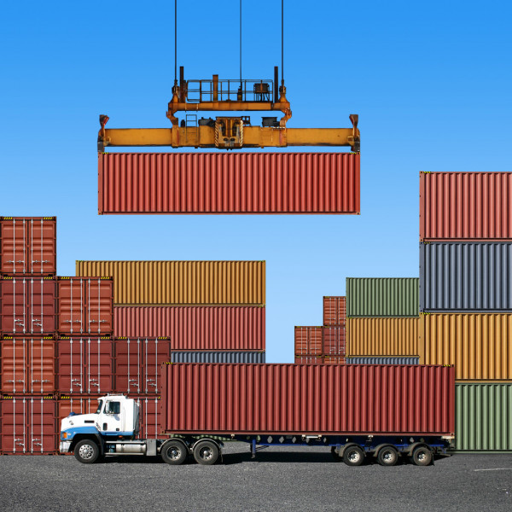
Truck Scheduling at Container Terminals
Mie562 – Scheduling
Group 5

Slide 2
Agenda
Problem Definition
Instances
MIP Formulation
CP Formulation
Results & Discussion
Demo Instance
1 instance
Notes:
Dylan

Slide 3
Background
Container ports are an integral part of international supply chain, primarily to transship goods from international carriers to domestic shipping containers. Ocean containers need to be delivered from container terminals (seaport) after being discharged from container ships, and sent to a transloading facility, where product is transloaded (cross-docked) onto a domestic truck/rail for delivery to a distribution center further down the supply chain.
There are several soft deadlines on containers that need to be met, otherwise extra costs will be incurred
Ships arrive every 1-3 days with 20-80 containers/ship
Real problem from Halifax, NS

Slide 4
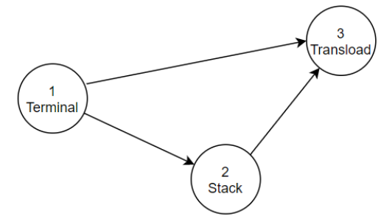
Problem Definition
To avoid financial penalty at the container terminal; optional choice of sending containers to cheap external temporary storage called the stack
Containers are moved between locations on container beds called chassis
Primary resource of the problem, required to:
move containers between locations
process containers at transload (takes 1-5 days typically)
Limited in number (~25)
Containers are removed from chassis at stack
i.e resource can be released for duration spent at stack
Primary
Optional

Slide 5
Costs
For both models, our objective is to minimize the total following operational costs:
Demurrage Cost – Depends on shipping carrier, containers have a few free storage days at the terminal after being discharged from a ship. After this period, there is a cost incurred daily.
E.g., Days 1-5: free, Day 6+: $100/container/day)
Detention Cost – Depends on shipping carrier, containers have a few weeks to be unloaded after being discharged from the ship. After this period, there is a cost incurred daily until the container is returned to the terminal (e.g., $200/container/day)
Stack Cost– Fixed cost to enter/leave the storage yard, with a cheap cost incurred daily
I.e., Pay initial $300/container fee to use the yard + $15/container/day. High initial cost.
Priority – Containers are given a priority level based on contents of container (to prevent stockouts at DC, etc.)
A pseudo penalty is added objective functions to process higher priorities first
Notes:
Demurrage – Tardiness at Terminal –
Detention – Soft Container “Due Date”

Slide 6
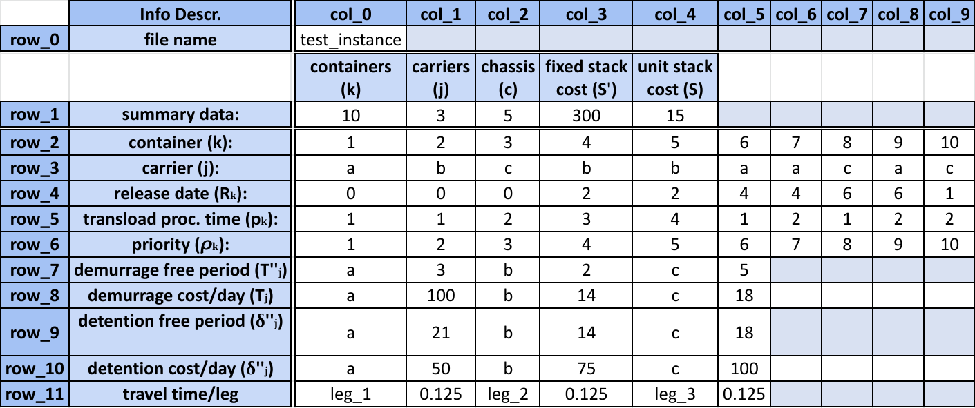
Problem Instances - Format

Slide 7
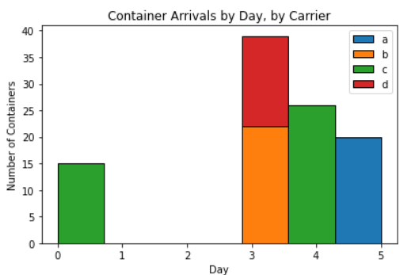
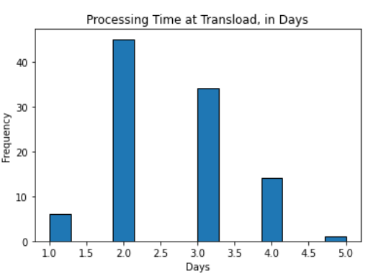
Problem Instances - Sample

Slide 8
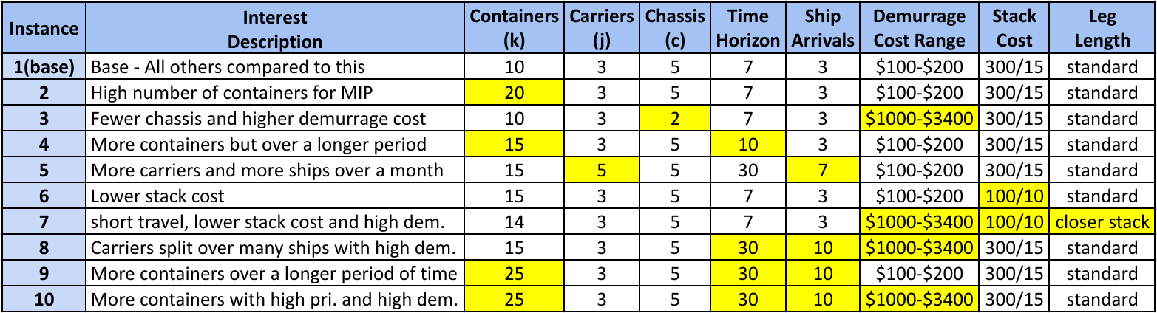
Problem Instances - Summary

Slide 9
First Model
Mixed Integer Programming model

Slide 10
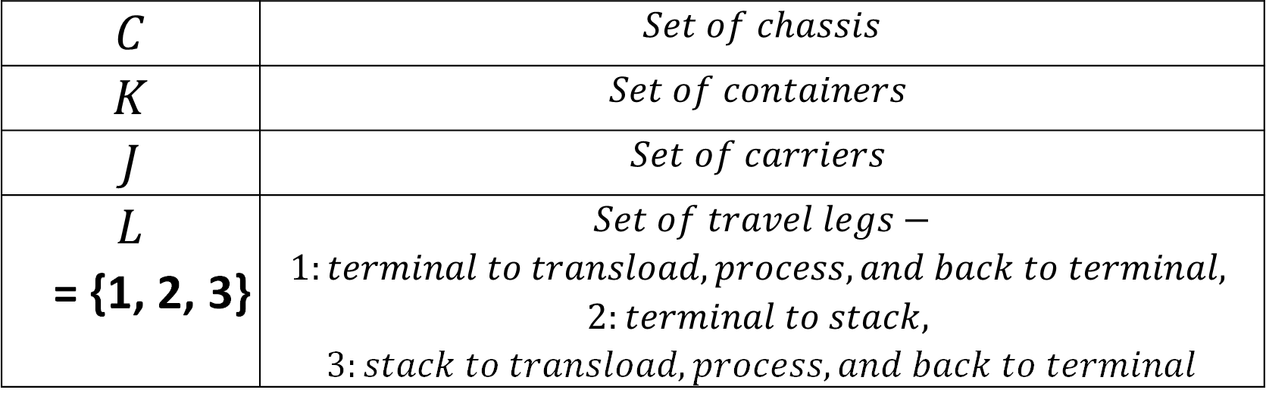
Sets
$$C$$ | $$Set of chassis$$
$$K$$ | $$Set of containers$$
$$J$$ | $$Set of carriers$$
$L$ = {1, 2, 3} | $$Set of travel legs−$$ $$1:terminal to transload, process, and back to terminal,$$ $$2:terminal to stack,$$ $3:stack to transload, process, and back to terminal$
Notes:
Recap problem:
Legs defined this way because each represents a single transport job that a chassis would take

Slide 11
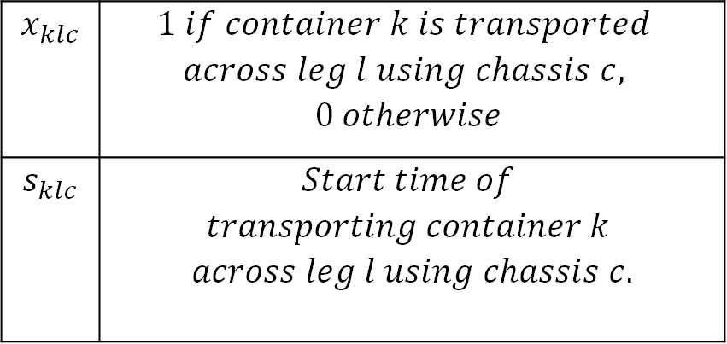
Variables
Variables:
$$x_{klc}$$ | $$1 if container k is transported$$ $$across leg l using chassis c,$$ $$0 otherwise$$
$$s_{klc}$$ | $$Start time of$$ $$transporting container k$$ $$across leg l using chassis c.$$
Notes:
Emphasize the resemblance to both an assignment problem and disjunctive JSP model

Slide 12
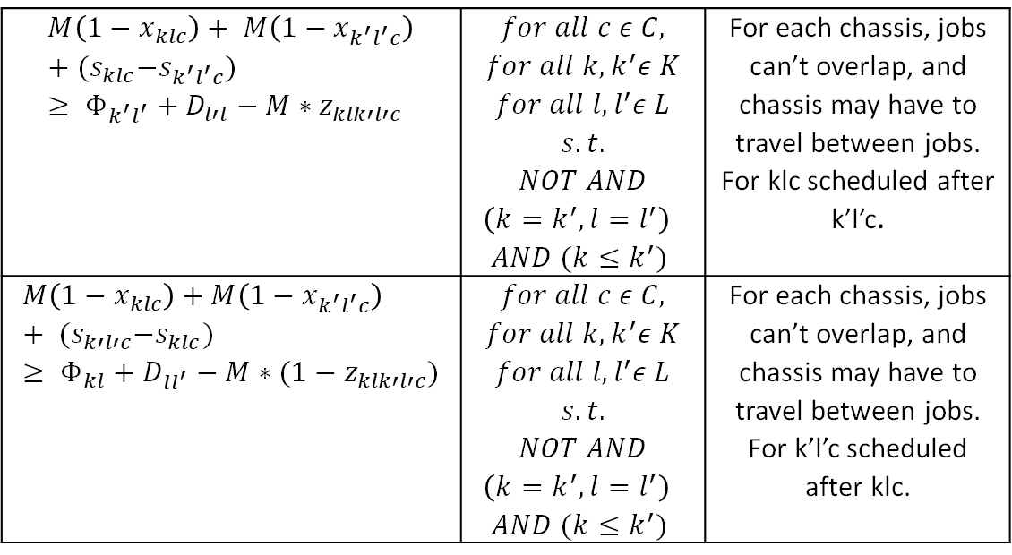
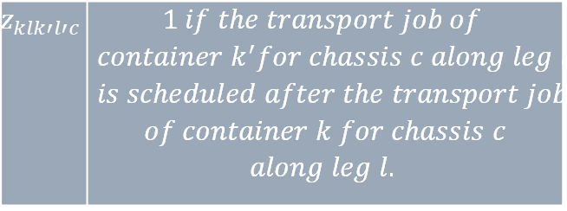
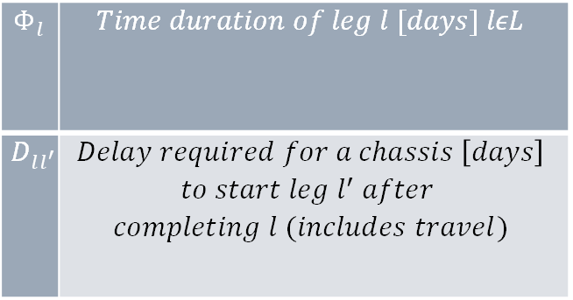
Chassis Constraints
$$M\left(1−x_{klc}\right)+ M\left(1−x_{k^{′}l^{′}c}\right)+{(s}_{klc}−s_{k^{′}l^{′}c})≥ Φ_{k^{′}l^{′}}+D_{l′l}−M∗z_{klk′l′c}$$ | $$for all c ε C,$$ $$for all k, k^{′}ε K$$ $$for all l, l^{′}ε L$$ $$s.t.$$ $$NOT AND$$ $$\left(k=k^{′}, l=l^{′}\right)$$ $AND (k≤k^{′})$ | For each chassis, jobs can’t overlap, and chassis may have to travel between jobs. For klc scheduled after k’l’c.
$$M\left(1−x_{klc}\right)+M\left(1−x_{k^{′}l^{′}c}\right) + {(s}_{k′l′c}−s_{klc})≥ Φ_{kl}+D_{ll^{′}}−M∗(1−z_{klk′l′c})$$ | $$for all c ε C,$$ $$for all k, k^{′}ε K$$ $$for all l, l^{′}ε L$$ $$s.t.$$ $$NOT AND$$ $$\left(k=k^{′}, l=l^{′}\right)$$ $AND (k≤k^{′})$ | For each chassis, jobs can’t overlap, and chassis may have to travel between jobs. For k’l’c scheduled after klc.
$$Φ_{l}$$ | $$Time duration of leg l [days] lεL$$
$$D_{ll^{′}}$$ | $$Delay required for a chassis \left[days\right]$$ $$to start leg l^{′} after$$ $$completing l (includes travel)$$
$$z_{klk′l′c}$$ | $$1 if the transport job of$$ $$container k^{′}for chassis c along leg l^{′}$$ $$is scheduled after the transport job$$ $$of container k for chassis c$$ $$along leg l.$$

Slide 13
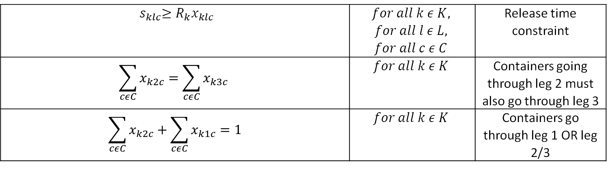
Constraints (2)
$$R_{k}$$ | $$Release time of container k [days]$$
$${ s}_{klc}≥R_{k}x_{klc}$$ | $$for all k ε K,$$ $$for all l ε L,$$ $$for all c ε C$$ | Release time constraint
$$\sum_{cεC}{x_{k2c}}=\sum_{cεC}{x_{k3c}}$$ | $$for all k ε K$$ | Containers going through leg 2 must also go through leg 3
$$\sum_{cεC}{x_{k2c}}+\sum_{cεC}{x_{k1c}}=1$$ | $$for all k ε K$$ | Containers go through leg 1 OR leg 2/3

Slide 14
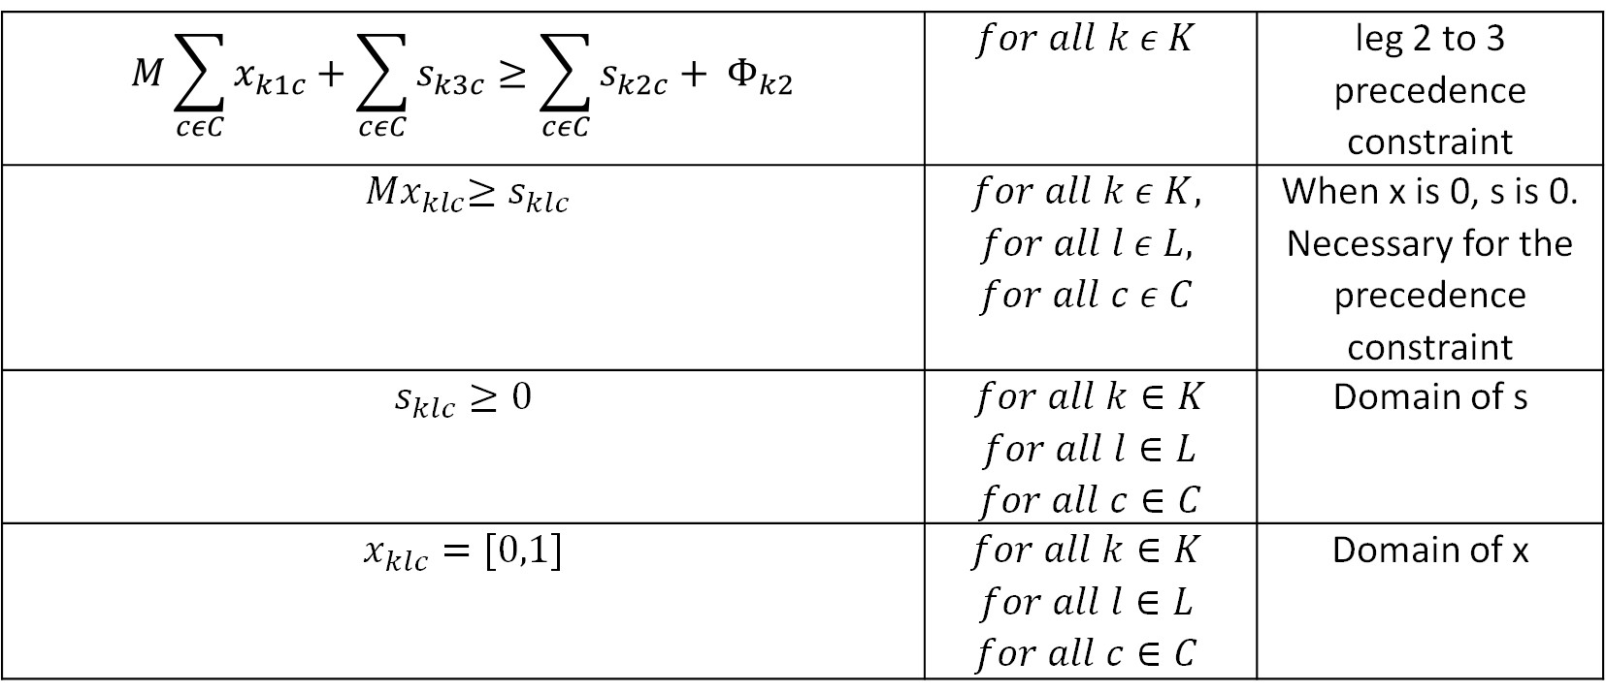
Constraints (3)
$$M\sum_{cεC}{x_{k1c}}+\sum_{cεC}{s_{k3c}}≥\sum_{cεC}{s_{k2c}}+ Φ_{k2}$$ | $$for all k ε K$$ | leg 2 to 3 precedence constraint
$${ Mx}_{klc}≥s_{klc}$$ | $$for all k ε K,$$ $$for all l ε L,$$ $$for all c ε C$$ | When x is 0, s is 0. Necessary for the precedence constraint
$$s_{klc}≥0$$ | $$for all k∈K$$ $for all l∈L$ $for all c∈C$ | Domain of s
$$x_{klc}=[0,1]$$ | $$for all k∈K$$ $$for all l∈L$$ $$for all c∈C$$ | Domain of x

Slide 15
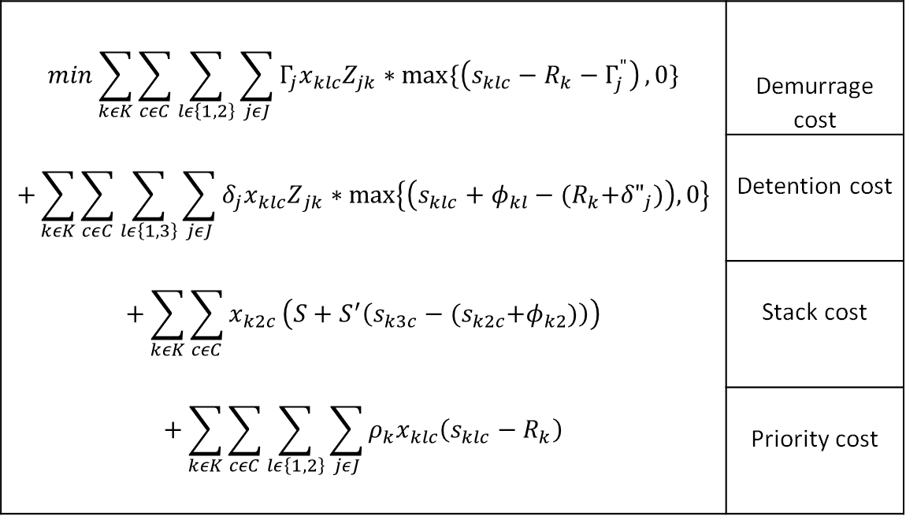
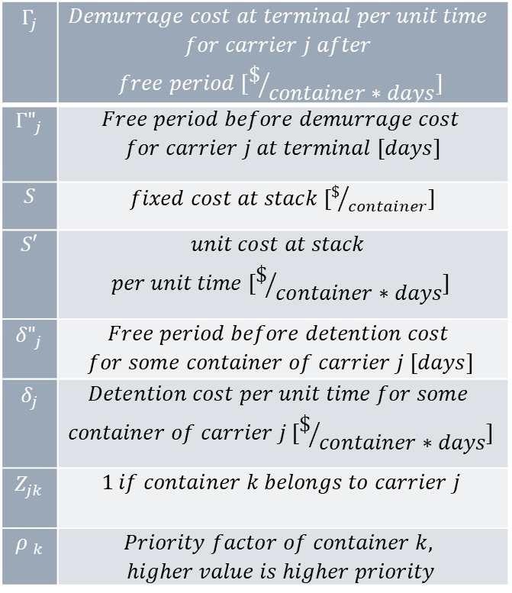
MIP Objective Function
$$Γ_{j}$$ | $$Demurrage cost at terminal per unit time$$ $$for carrier j after$$ $$free period [\$/{container∗days}]$$
$${Γ"}_{j}$$ | $$Free period before demurrage cost$$ $for carrier j at terminal [days]$
$$S$$ | $fixed cost at stack [\$/{container}]$
$$S′$$ | $$unit cost at stack$$ $$per unit time [\$/{container∗days}]$$
$${δ"}_{j}$$ | $$Free period before detention cost$$ $$for some container of carrier j [days]$$
$$δ_{j}$$ | $$Detention cost per unit time for some$$ $$container of carrier j [\$/{container∗days}]$$
$$Z_{jk}$$ | $$1 if container k belongs to carrier j$$
$${ρ }_{k}$$ | $$Priority factor of container k,$$ $$higher value is higher priority$$
$$min\sum_{kεK}{\sum_{cεC}{\sum_{lε\left\{1,2\right\}}{\sum_{jεJ}{Γ_{j}x_{klc}Z_{jk}∗max⁡\{\left(s_{klc}−R_{k}−Γ_{j}^{"}\right)}}},0\}}$$ $$+\sum_{kεK}{\sum_{cεC}{\sum_{lε\left\{1, 3\right\}}{\sum_{jεJ}{δ_{j}{x_{klc}Z}_{jk}∗\max\left\{\left(s_{klc}+φ_{kl}−{(R}_{k}+{δ"}_{j})\right), 0\right\}}}}}$$ $$+\sum_{kεK}{\sum_{cεC}{x_{k2c}}\left(S+S^{′}\left(s_{k3c}−{(s}_{k2c}+φ_{k2})\right)\right)}$$ $$+\sum_{kεK}{\sum_{cεC}{\sum_{lε\left\{1, 2\right\}}{\sum_{jεJ}{ρ_{k}x_{klc}\left(s_{klc}−R_{k}\right)}}}}$$ | Demurrage cost
 | Detention cost
 | Stack cost
 | Priority cost

Slide 16
Second Model
Constraint Programming model

Slide 17
CP Formulation
The main idea behind the CP model was to represent the time in the transload facility as an interval that must be included, and an optional interval of time to represent the time spent in the stack.
Dealing with parallel resources: Cumulative resources constraints
Similar model compared to MIP. Simplified resource as cumulative, optional legs
Solver used: IBM ILOG CPlex Optimizer for Python (docplex).

Slide 18
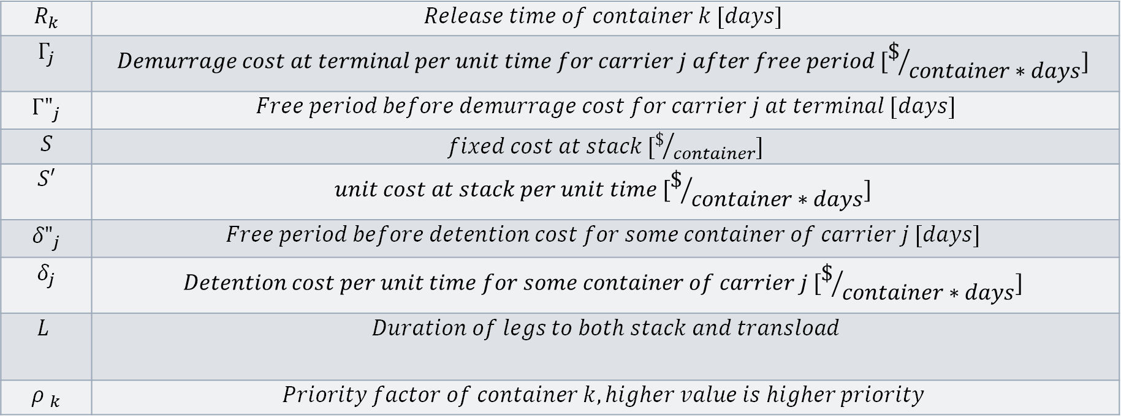
CP Parameters
$$R_{k}$$ | $$Release time of container k [days]$$
$$Γ_{j}$$ | $$Demurrage cost at terminal per unit time for carrier j after free period [\$/{container∗days}]$$
$${Γ"}_{j}$$ | $Free period before demurrage cost for carrier j at terminal [days]$
$$S$$ | $fixed cost at stack [\$/{container}]$
$$S′$$ | $$unit cost at stack per unit time [\$/{container∗days}]$$
$${δ"}_{j}$$ | $$Free period before detention cost for some container of carrier j [days]$$
$$δ_{j}$$ | $$Detention cost per unit time for some container of carrier j [\$/{container∗days}]$$
$$L$$ | $$Duration of legs to both stack and transload$$
$${ρ }_{k}$$ | $$Priority factor of container k, higher value is higher priority$$

Slide 19
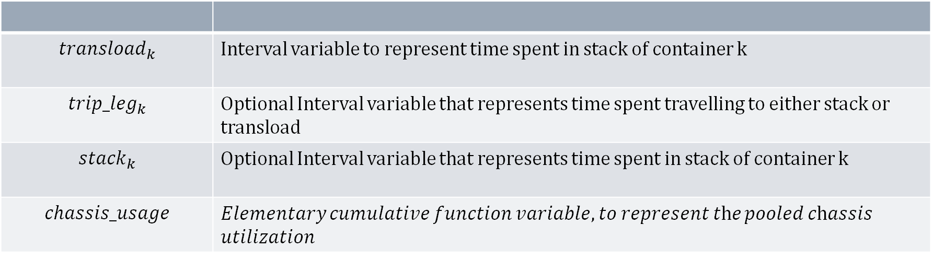
CP Decision Variables
$${transload}_{k}$$ | Interval variable to represent time spent in stack of container k
$${trip_leg}_{k}$$ | Optional Interval variable that represents time spent travelling to either stack or transload
$${stack}_{k}$$ | Optional Interval variable that represents time spent in stack of container k
$$chassis_usage$$ | 𝐸𝑙𝑒𝑚𝑒𝑛𝑡𝑎𝑟𝑦 𝑐𝑢𝑚𝑢𝑙𝑎𝑡𝑖𝑣𝑒 𝑓𝑢𝑛𝑐𝑡𝑖𝑜𝑛 𝑣𝑎𝑟𝑖𝑎𝑏𝑙𝑒, 𝑡𝑜 𝑟𝑒𝑝𝑟𝑒𝑠𝑒𝑛𝑡 𝑡h𝑒 𝑝𝑜𝑜𝑙𝑒𝑑 𝑐h𝑎𝑠𝑠𝑖𝑠 𝑢𝑡𝑖𝑙𝑖𝑧𝑎𝑡𝑖𝑜𝑛

Slide 20
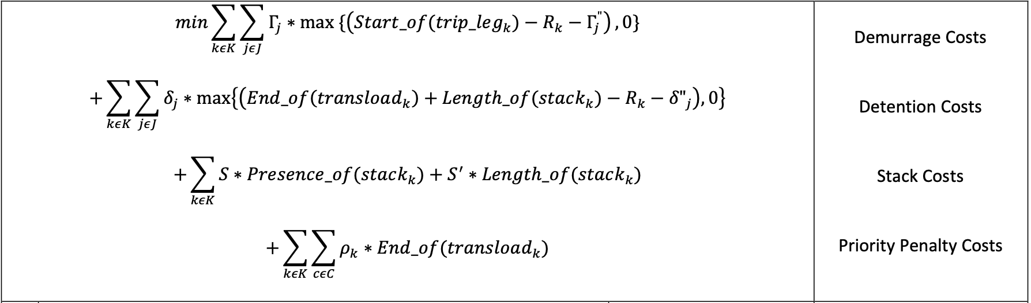
CP Objective Function

Slide 21
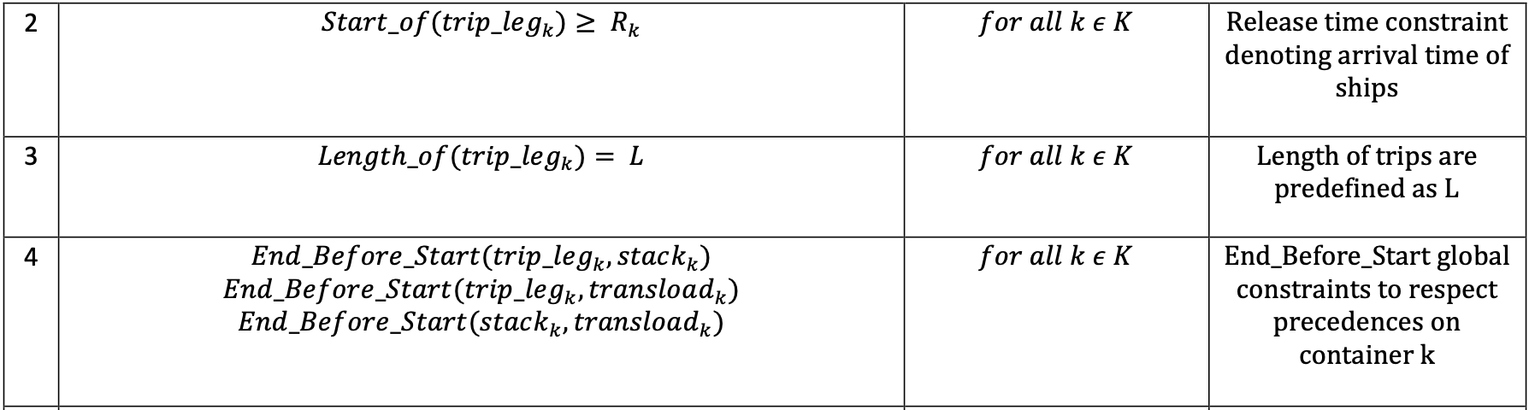
Constraints

Slide 22
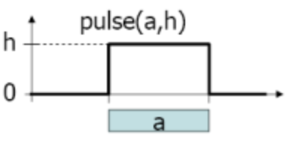
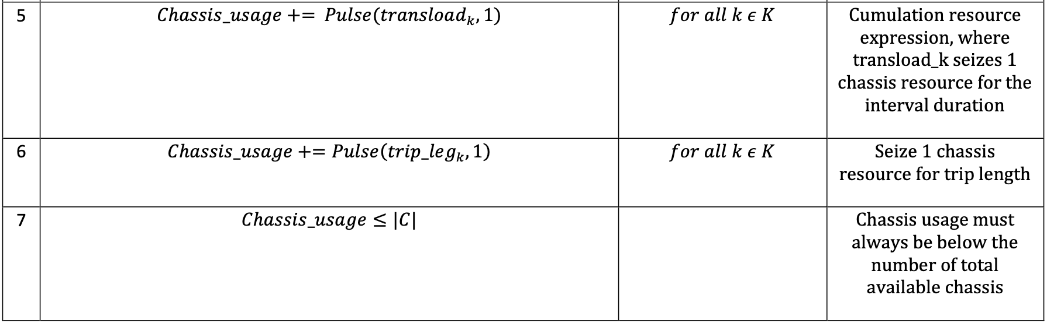
Resource Constraints

Slide 23
Results Comparison

Slide 24
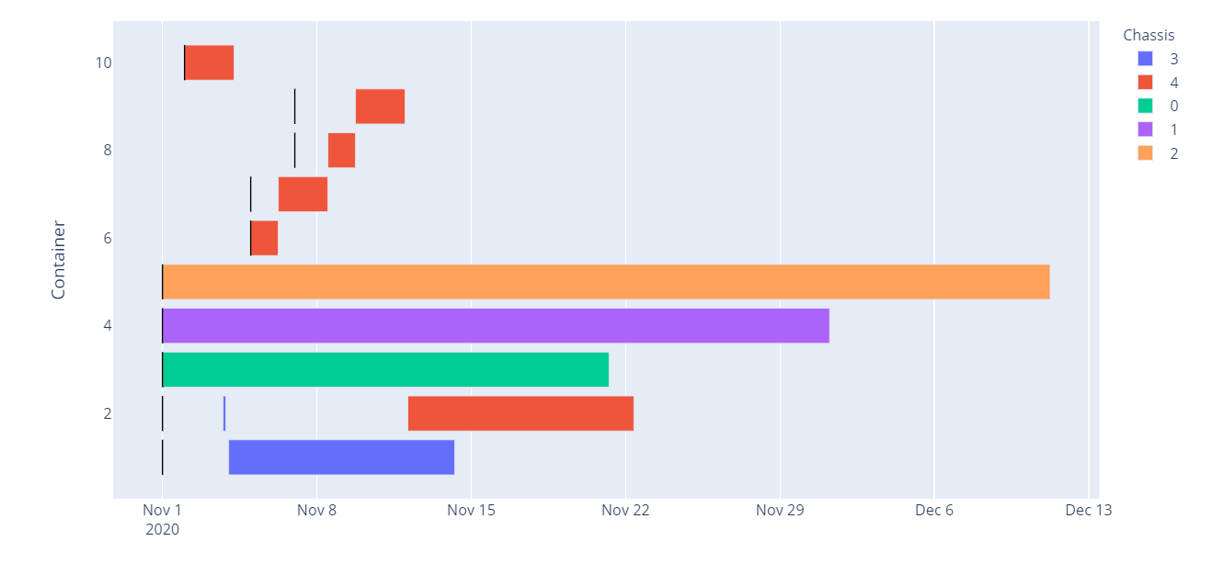
MIP Chart
Notes:
Plotly and pandas

Slide 25
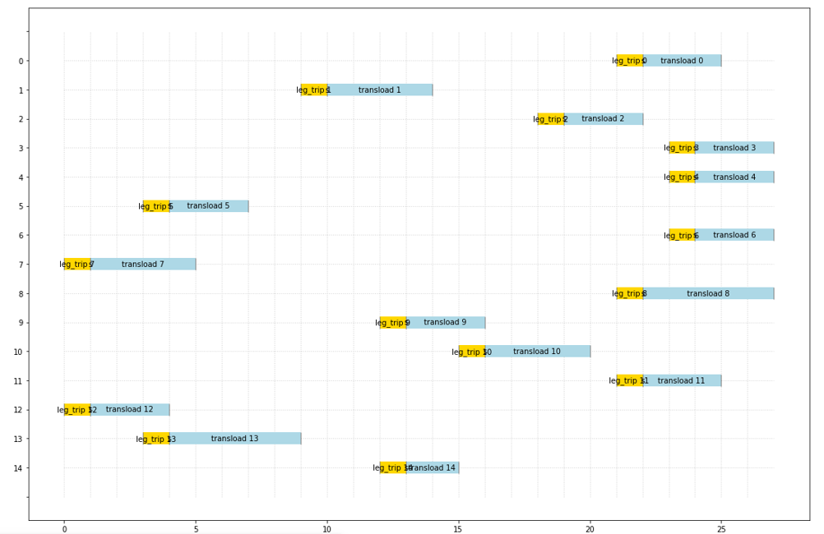
CP Chart
Notes:
Docplex and matplotlib

Slide 26
Results
Instances | MIP Peformance (Time and Gap) |  | CP Performance (Time and Gap)
1) 10 ct, 3 ca, 5 ch, 7 days | 1 minute limit | 9.2% | 0.51 seconds | optimal
2) 20 ct, 3 ca, 5 ch, 7 days | 1 minute limit | 100% | 1 minute limit | 38%
3) 10 ct, 3 ca, 2 ch, 7 days | 38.98 seconds | Optimal | 10.19 seconds | Optimal
4) 15 ct, 3 ca, 5 ch, 10 days | 31.20 seconds | Optimal | 1.57 seconds | optimal
5) 15 ct, 5 ca, 5 ch, 30 days | 1 minute limit | 23.1% | 0.56 seconds | optimal
6) 15 ct, 3 ca, 5 ch, 7 days | 1 minute limit | 100% | 2.02 seconds | optimal
7) 14 ct, 3 ca, 5 ch, 7 days | 1 minute limit | 100% | 27.37 seconds | optimal
8) 16 ct, 3 ca, 5 ch, 30 days | 11.54 seconds | Optimal | 0.72 seconds | optimal
9) 25 ct, 3 ca, 5 ch, 30 days | 36.62 seconds | Optimal | 2.36 seconds | optimal
10) 25 ct, 3 ca, 5 ch, 30 days* | 37.39 seconds | Optimal | 5.12 seconds | optimal
* high priority and high costs
Notes:
CP model was better than MIP model: MIP = 5/10 ; CP = 9/10

Slide 27
Discussion
Keynotes
Less days = harder problem
Less chassis = easier problem
Higher number of containers = harder problem
Different costs and priorities = same problem
Instance 2
No models found optimal solution
High number of containers in short period of time
Limitations
Symmetry was an issue
MIP model had a variable with 5 subscripts

Slide 28
System Demo
Mixed integer programming model

Slide 29
References
Gökgür, B., Hnich, B., & Özpeynirci, S. (2018). Parallel machine scheduling with tool loading: A constraint programming approach. International Journal of Production Research, 56(16), 5541–5557. https://doi.org/10.1080/00207543.2017.1421781
Baptiste, P., Laborie, P., Pape, C. L., & Nuijten, W. (2006). Constraint-based scheduling and planning. In Foundations of Artificial Intelligence (Vol. 2, pp. 761–799). Elsevier. https://doi.org/10.1016/S1574-6526(06)80026-X

Slide 30
Thank you
Questions?

